Slide 1
A HamSCI Experiment NVARC and the Eclipse
Join us!
Notes:
Authored by Stan Pozerski KD1LE

Slide 2
Background
Pepperell MA, 20 April 2017. The Nashoba Valley ARC (NVARC) was hosted for its April meeting by member Dr Phil Erickson, W1PJE, at the MIT Haystack Observatory. Highlights of the meeting included a talk on E‑skip by club member Joe Dzekevich, K1YOW, discussions with 25 visiting students from the University of Pennsylvania, and a tour of the Haystack radiotelescope.
Also at the meeting Dr Erickson and Stan Pozerski, KD1LE, announced
a new cooperative arrangement between NVARC and Haystack which will encompass (among other things yet to be proposed) mutual outreach to youth, the possibility of joint EME activities, and the conduct of “HamSCI” experiments.

Slide 3
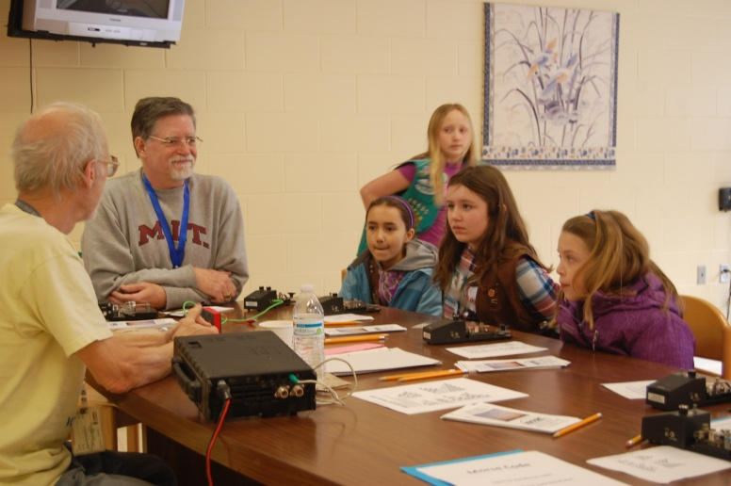
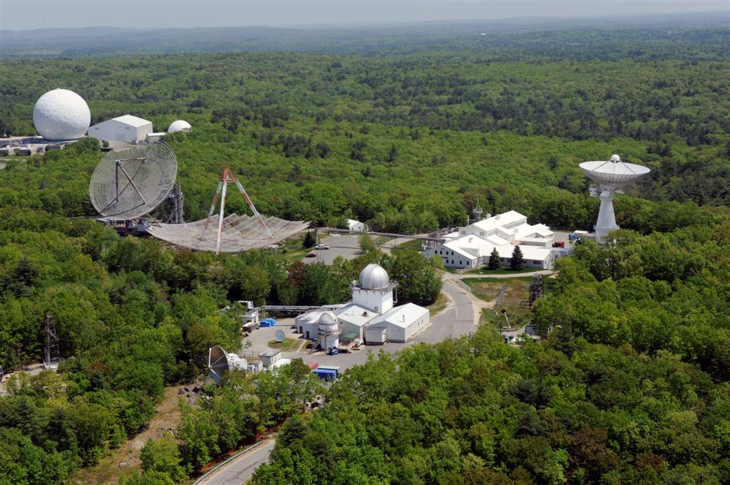
An Exciting Association

Slide 4
What is this HamSCI all about?
The HamSCI (Ham Radio Science Citizen Investigation, www.hamsci.org/) goal is to advance the field of radio science.
An upcoming experiment is a collaboration between HamSCI, ARRL, and the scientific community to collect data to advance the understanding of D- and E-layer propagation.

Slide 5
There’s an Eclipse Coming
On 21 August 2017, a total solar eclipse will cause the shadow of the moon
to traverse the United States from Oregon to South Carolina
in just over 90 minutes. NEXT CHANCE – SEVEN YEARS AWAY!

Slide 6
The 21 August Experiment
HamSCI will collect a large data set from the larger “citizen population” that would not otherwise be available for the Ham and Scientific Community.
There is no specific theory or premise supposed here.
This data will be used to advance our understanding of D- and E- layer propagation.

Slide 7
The Experiment
Behind the experiment is the challenge to take data from a variety of “semi-scientific” sources and combine it into useful information for analysis
The sources here are the Solar Eclipse QSO Party contact logs, the Reverse Beacon Network, and the WSPRnet database

Slide 8
Many Ways to Participate
(EASIEST) Get on the air and make contacts on 160 to 6 meters 1400 – 2200z (but not 60m or the WARC bands).
Modes include CW, Digital and phone. In digital modes send data to PSKReporter if it is an option
Transmission format “CQ CQ TEST DE callsign” for best automated receiving. The exchange is receiving callsign, signal report, six character grid locator, your callsign. Actual Signal strength preferred but 59 or 599 OK
Log in software that supports SEQP or ARRL VHF contest exchange. More on SEQP website.
Submit a log of your contacts

Slide 9
Many Ways to Participate
2. (EASY) Set up WSPR on any sound card configured radio and computer. Monitor (receive only) and report.
No CAT, antenna switching, or tuning issues
An advantage of WSPR is it runs continuously so more data will be collected
With an Internet connection WSPR data can be automatically uploaded to the WSPRnet database
But you won’t get any QSL cards.

Slide 10
Many Ways to Participate
(MORE CHALLENGING) Activate a WSPR beacon
Any band(s), 160 to 6 meters (but not 60m)
Automatically upload reports
You’ll be both a signal and an information source!
(WICKED) An even more complex way is to build and operate a multi-band beacon like the QRP Labs Ultimate3. And add a monitor station… And get on the air, too…
(AWESOME) Help others get set up.

Slide 11
How to Create Data
Set up as many Internet-connected monitor stations as possible.
Put the most stations on the air from 1546Z 1146L to 2104Z 1704L on 21 August.
Better if WSPR beacon stations were on for at least a few hours before and after that time.
Even better a day either side of that date for reference.
Coordinate our activity so we are not all doing the same thing (band or mode)

Slide 12
How to Best Support
Run WSPR in a single band mode. This gives the finest data resolution over time. (WSPR operates on a 2 minute period which may be transmit or receive starting on the even minutes)
Set up on a band 160-6 meters.
40, 20, and 10 meters have the most current activity so try activating other bands.
Use a power setting of five watts or less

Slide 13
Conclusion
Join in! Identify a local coordinator. Let Phil or HamSCI know you’re participating.
Participation can be simple by just making contacts and submitting your log.
There should be a level that everyone can participate and contribute.
My personal goal is for NVARC to run 15 WSPR stations. We have twelve WSPR and one QRPLabs beacon committed.

Slide 14
References and Links
Solar Eclipse Project http://hamsci.org/eclipse
Solar Eclipse QSO Party (http://hamsci.org/seqp)
WSPRnet homepage http://wsprnet.org/drupal/
Source for WSPR https://physics.princeton.edu/pulsar/k1jt/wspr.html

Slide 16
WSPR
“Weak Signal Propagation Reporter”
Probes radio frequency propagation conditions by using very low power (QRP/QRPp) transmissions
WSPR receivers detect and decode, and can directly report to the Internet.
You can beacon, or receive, or both.

Slide 17
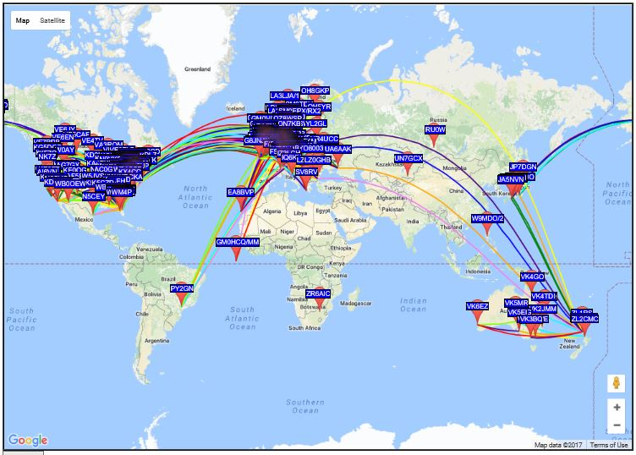
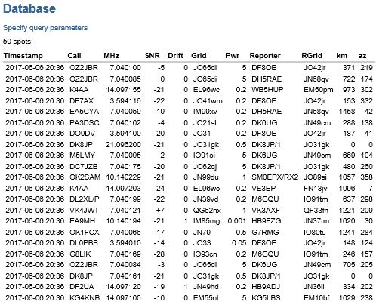
WSPRnet
http://wsprnet.org/drupal/

Slide 18
Setting up WSPR
Very easy to set up on a radio/computer configured for sound card mode operation
Pull down and install WSPR from https://physics.princeton.edu/pulsar/k1jt/wspr.htm
For the basic set-up you only need to enter your call sign, grid square (4 or 6 character), the audio input and output sources and power level in dBm (from a chart in the instructions)

Slide 19
Your WSPR Station
Connect an appropriate antenna for the band you wish to operate on.
Set your transmitter to an appropriate (about 5w) power level.
Choose the band/frequency in WSPR and set the radio to the indicated frequency.
Set the “% transmit” slider (20% default).
Uncheck the “idle” box.

Slide 20
WSPR Operating Screen

Slide 21
WSPR – on the air
Your computer clock needs to be accurate.
By default, Windows syncs to an NTP server once a week (or 604,800 sec).
Once a day is better. Reg SpecialPollInterval 86400 sec.
Based on two minute periods WSPR will transmit your information or listen for other WSPR signals. More complicated if you want to know?
Under the “file” pulldown “save user settings”

